Slide 1



Screentime to Studytime
“When the Phone Chimes, It’s Study Time”
by: Marco Pacad & Marthena Padayao

Slide 2


Table of Contents
  Problem Statement
  Project Description
  Objectives
  Planned features
  Planned Inputs & Outputs
  Steps on How to Run the Program
  Flowchart
  Example Output

Slide 3


Problem Statement
Some students struggle with focusing on studying/doing their requirements by getting distracted with using social media apps or games. This leads to worsening their study habits and getting low grades.

Slide 4




Project Description
The project “Screentime to Studytime” focuses on helping students reduce distractions from social media while studying for quizzes and exams. It aims to turn wasted screen time into productive study sessions through simple strategies and tools. This encourages better focus, discipline, and academic success.

Slide 5

Objectives
• Help students focus studying by having a pomodoro timer, which improves focus and prevents burnout, and a website blocker for no distractions.
• Motivate students by giving them motivation and rewards.

Slide 6

Features
Focus Timer – a built-in timer to manage study and break sessions (Pomodoro style).
Website Blocker – temporarily restricts access to distracting social media websites while studying.
Progress Tracker – monitors study hours and completed tasks.
Motivation Boost – reminders, quotes, or rewards to keep students encouraged.
Custom Study Plan – lets users set goals and organize subjects or topics efficiently.

Slide 7


Inputs & Ouputs
INPUTS:
• Subject that the user will study.
• Time to be spent studying.
• Websites that the user requests to block while studying.
OUTPUTS:
• Motivation Boost pop-up reminders/quotes/rewards
• Distraction Detector pop-up (if the user is trying to use an app )
• Tracked study hours

Slide 8
How to Run the Program:
1.Open the Program – launch the application on your device.
2.Set Your Study Plan – input the subject or task you want to focus on and the time you’ll spend.
3.Enter Unwanted Websites - input the link/s of the websites you want to temporarily block.
4.Start the Focus Timer – the program will block distracting apps and websites while you study.
5.Take Breaks – follow the timer’s scheduled breaks to rest and refresh.
6.Check Progress – after studying, view your tracked study hours and completed tasks.

Slide 9
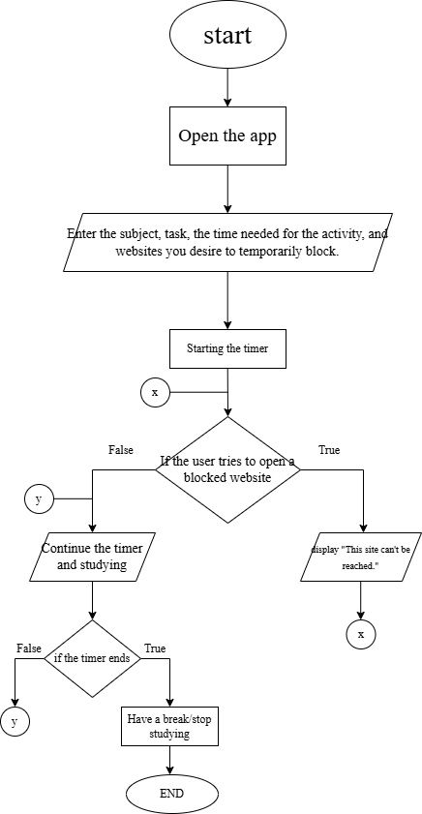
FLOWCHART

Slide 10

Example Output
Enter student name: Alice
Enter Subject, Task, and Time planned to Study: Biology, Quiz, 1 hour
Enter Unwanted Websites (link):
facebook.com
instagram.com
tiktok.com
Start Focus Timer
After study sesh...
Progress: You studied your biology quiz for 1 hour! Good Job!

Slide 11












Thank you!

